Slide 1
Connecting App Inventor with a Database
Presented by Kimberly Hermans
CSTA Annual Conference 2020

Slide 2
Prerequisites for this Presentation
Skills
Familiarity with App Inventor 2
Materials
Computer/Tablet with Compatible Browser
Mozilla Firefox 3.6 or higher (Note: If you are using Firefox with the NoScript extension, you'll need to turn the extension off. See the note on the troubleshooting page.)
Apple Safari 5.0 or higher
Google Chrome 4.0 or higher
App Inventor does not support Microsoft Internet Explorer. Windows users should use Chrome or Firefox
A Google account
Android device or emulator

Slide 3
Learning Objectives
By the end of this presentation, you will be able to:
Understand Firebase capabilities and limitations
Understand App Inventor 2 limitations with Firebase
Connect Firebase to your App
Set up a Realtime Database
Understand database structure
Add to your database
Read from your database
Update an object from your database
Remove an object from your database

Slide 4
What is Firebase? Is it for me?
Firebase is a comprehensive mobile development platform with many useful features
Ex. Analytics, Hosting, Authentication, Realtime Databases
Realtime Database is designed to update all connected devices in realtime
Stores data in a JSON (Javascript Object Notation) format
Limitations: Difficult to sort and search large amounts of data
Larger scale data consider Cloud Firestore (still in Beta)

Slide 5
What is a No-SQL Database?
A SQL Database is a database where everything is stored as a table with a set of fields
A No-SQL Database allows you to store anything you want to the database without following a specific format
JSON (JavaScript Object Notation) allows you to define fields for each individual object
Firebase is a No-SQL database that stores objects in a JSON format

Slide 6
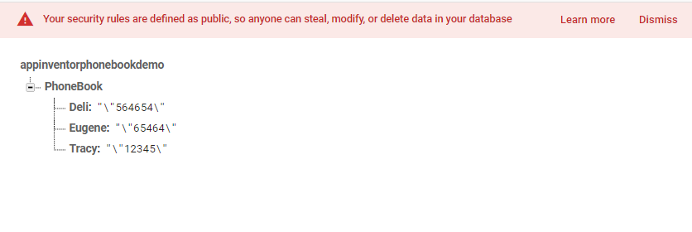
Limited Database Structure
Given the limited capabilities of App Inventor 2, it is recommended to have Key-Value pairs in buckets only

Slide 7
Setting Up New Project in Firebase
Requires log in with our Google account
Navigate to https://console.firebase.google.com
Click “Add Project”
Create A Project Step 1: Enter the project name
Create A Project Step 2: Decide if you want to set up Google Analytics (doesn’t matter for our project)
Create A Project Step 3: Select an account for Google Analytics, you may select the default

Slide 8
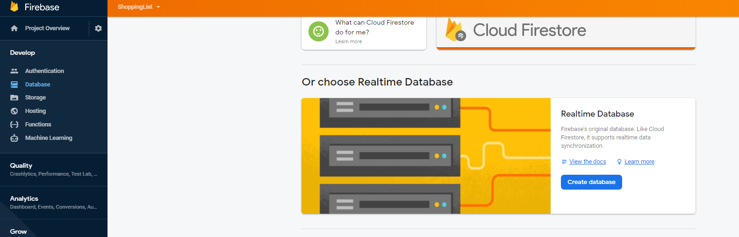
Setting Up Database
Select Database in the Develop menu on the left side of the screen
Scroll down until you see “Realtime Database”
Select “Create Database” (Do not confuse this with Could Firestore)

Slide 9
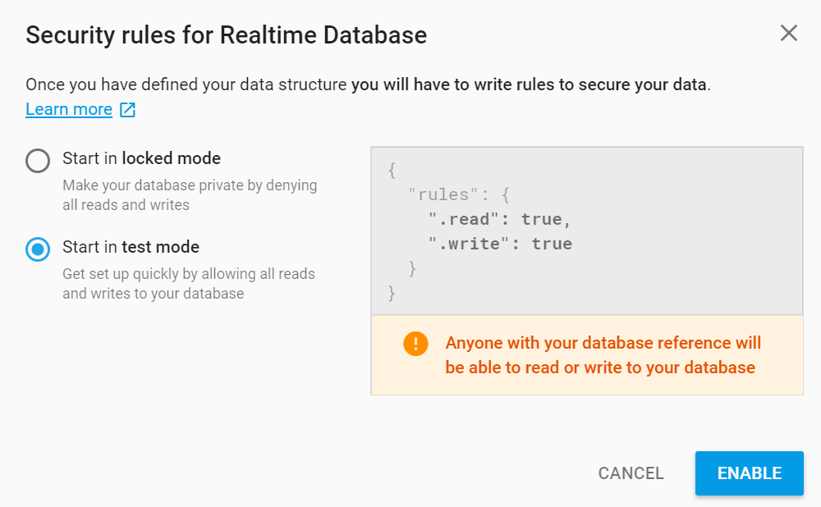
Test Mode
Database>Realtime Database
Select test mode
To change permissions, edit under “rules”

Slide 10
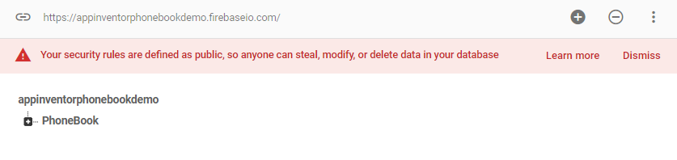
Copy the Link to your Database
You will need the URL/Link to your database, which you can find in the header of your database.

Slide 11
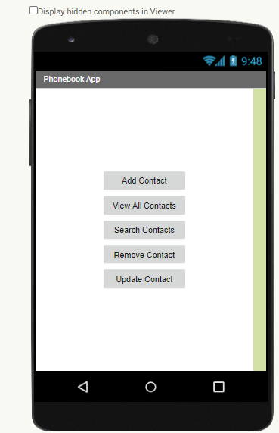
Example Activity: Developing a Simple Phonebook
The phonebook will simply store a contact name and a phone number in a database
This app will demonstrate the basic operations on a database
We will add, search, update, remove, and view all contacts of the phonebook
We will be limited in our capabilities based on App Inventor

Slide 12
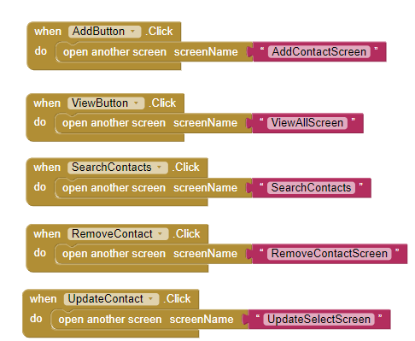
Home Page – Screen1

Slide 13
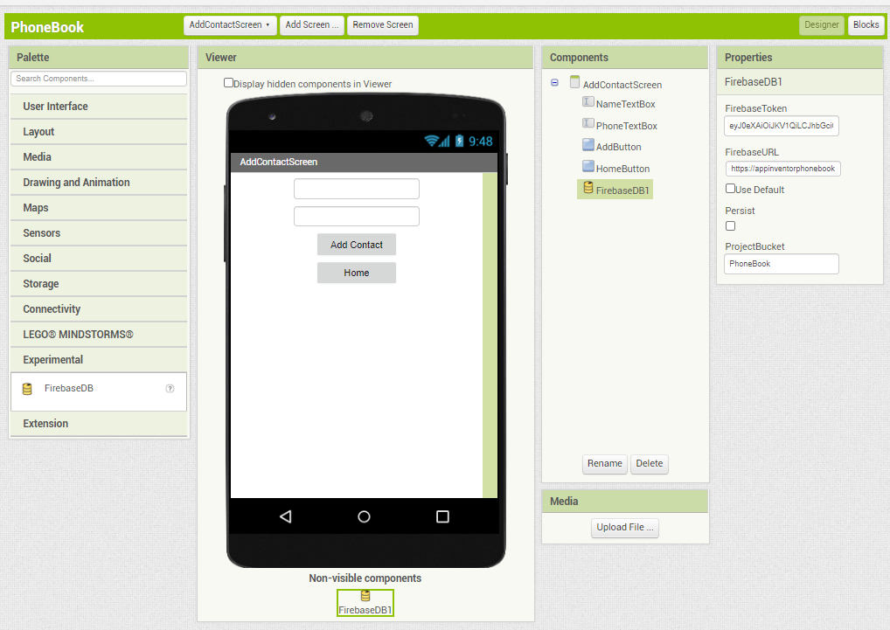
Adding To the Database
Any screen that accesses the database needs to have the FirebaseDB component added
You can add the FirebaseDB by dragging the component to the mobile device screen
You should see the non-visible component below the screen
Don’t forget to change the Firebase URL!

Slide 14
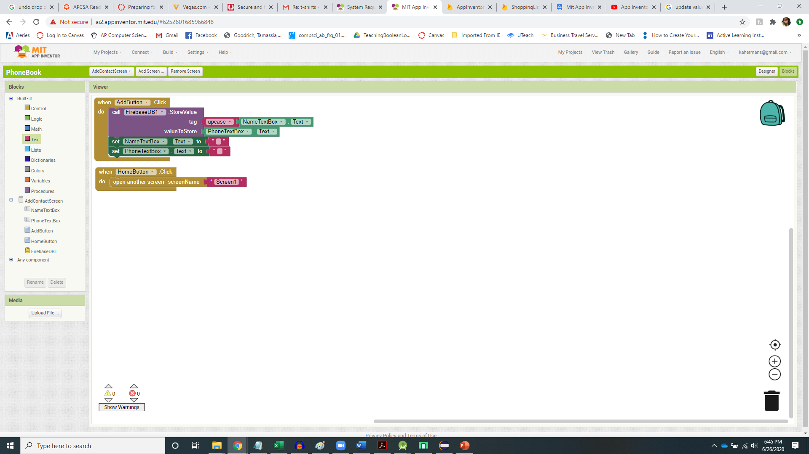
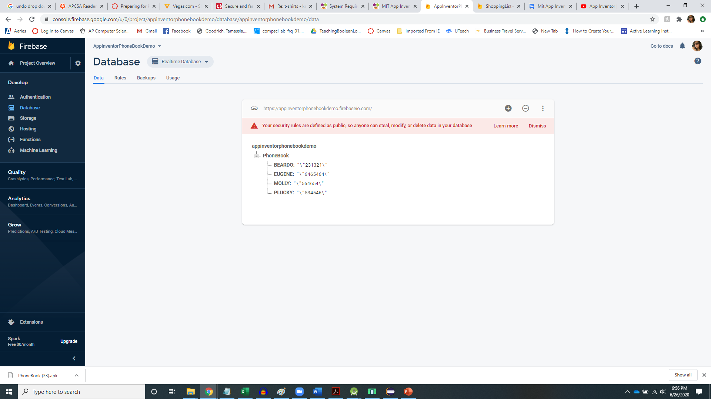
Adding To The Database
Adding to the database simply requires a key and a value
Check your database after you have run your app to be sure the database is updating
Note: All keys are upper case to make case insensitive searches possible
Notes:
This code is automatically generated when an activity is created.

Slide 15
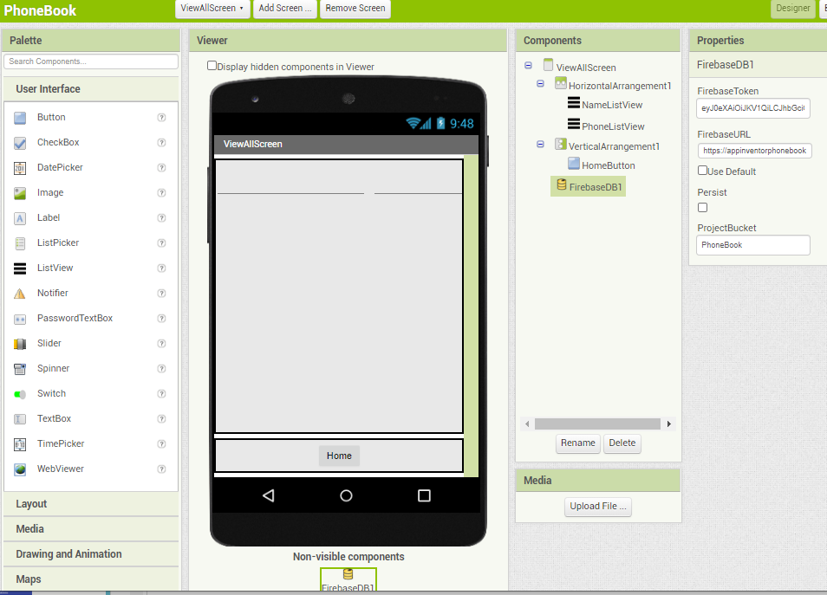
Accessing All Data
We will need to add the FirebaseDB component to our new screen.
We will use two ListView components to organize our data: One ListView will contain all the names, and the other ListView will contain all the phone numbers
Don’t forget to update your FirebaseDB URL!!

Slide 16
Understanding GetTagList
A “call GetTagList” block in itself does nothing, but it does call the “when TagList” block.
Define the “when TagList” block
“value” refers to a list of tags, or keys in our key-value pair. In our example, “value” is the list of all names in our phonebook (Ex. [“BEARDO”, “EUGENE”, “MOLLY”])
Traverse the “value” list to visit each tag/key in the database using the “for each” block

Slide 17
A Note About Asynchronous Programming
Javascript uses a concept called asynchronous programming for optimization
This does not apply to other languages like Java, Python, C++
This means that a procedure may not be done running before another procedure is called.
Why is this important? If the results of one procedure call is dependent on the results of another procedure call, you may not have the results you need in time.
So… what does that mean I have to do? Anything that is dependent on the results of something else needs to be in the same procedure.
Example
procedure A
a = procedure1( )
b = procedure2( )
x = a + b
//May result in a blank answer because procedures 1 & 2
// are not guaranteed to have finished
procedure A
a = some calculations
b = some calculations
x = a + b
// x will have a value because //there are no procedure calls

Slide 18
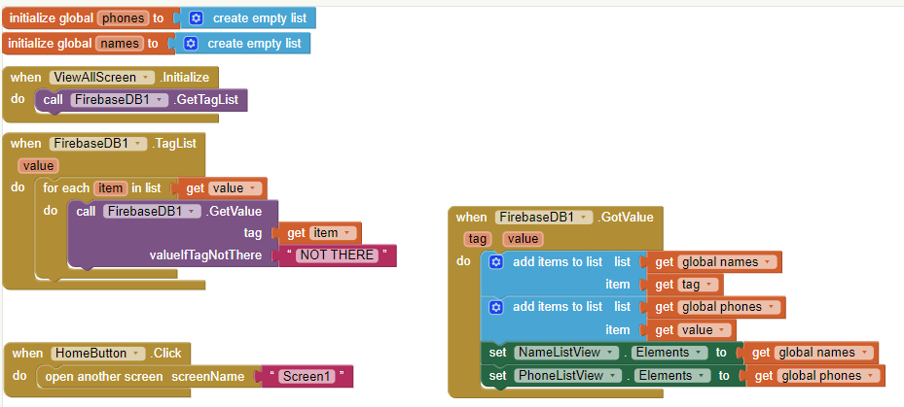
Accessing All Data
NOT HERE
Potential asynchronous issue.. Must go here!

Slide 19
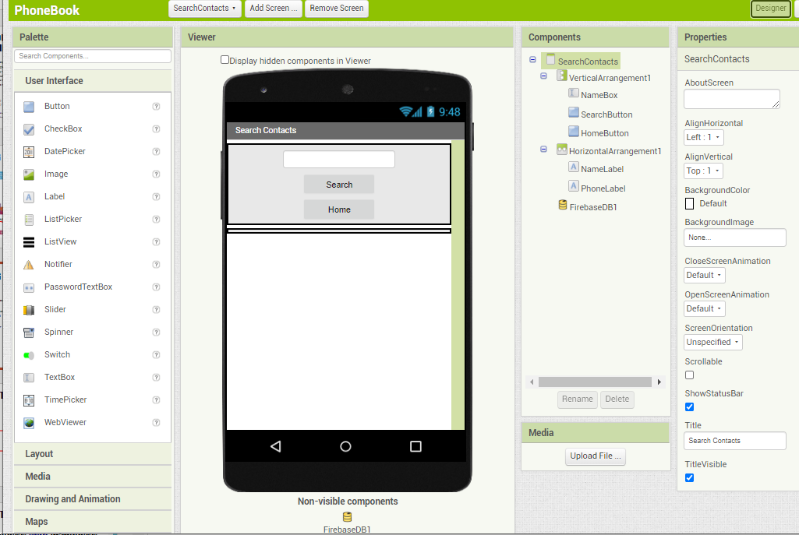
Searching Data
We will need to add the FirebaseDB component to our new screen.
Searching is similar to accessing the database, but instead of traversing the list of tags, we can check if a tag is in the list.
Don’t forget to update your FirebaseDB URL!!

Slide 20
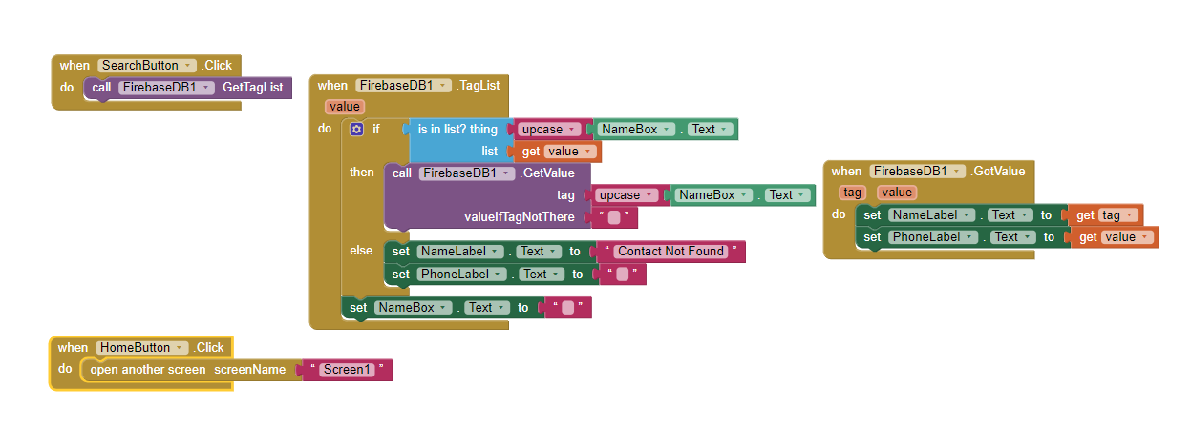
Searching Data

Slide 21
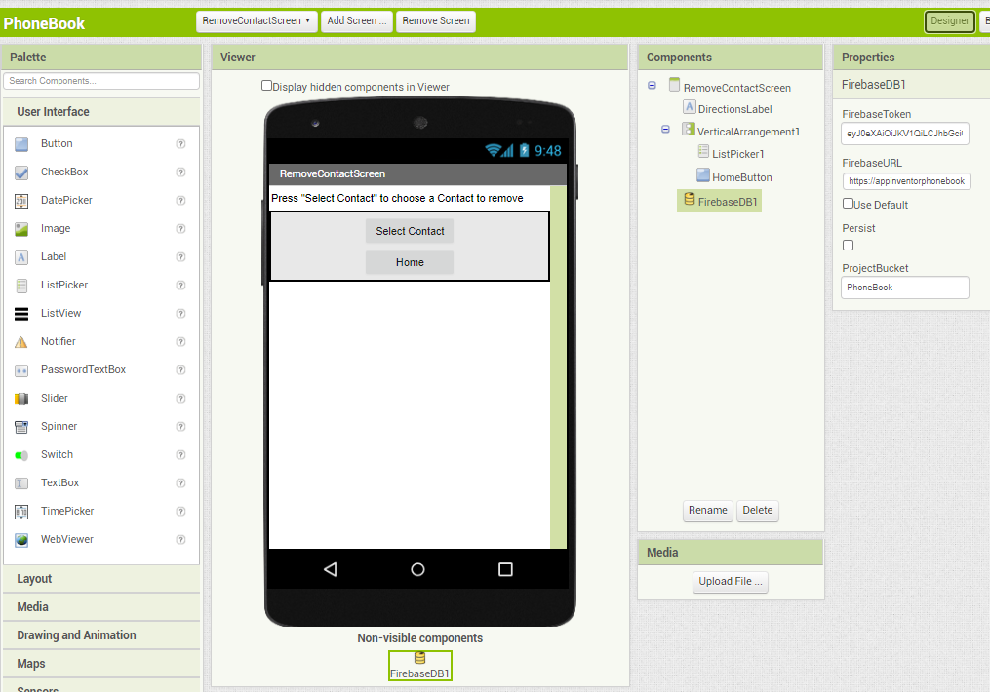
Removing Data
Use a ListPicker so the user can select from a list what they want to remove
Will need to create a list, each element will be a string of the joined name and number
Setting up the ListPicker is similar to setting up the two ListViews
Use the “when AfterPicking” block to delete, using the “call ClearTag” block.
ClearTag block needs a key to remove the key-value pair
Call GetTagList to refresh the ListPicker
Note: Does not appear to remove the last contact from the list in the App even though it’s removed on Firebase

Slide 22
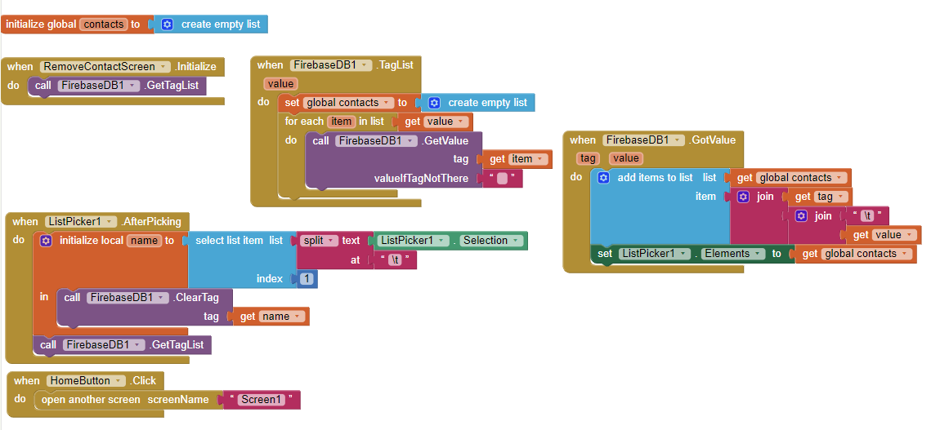
Removing Data

Slide 23

Updating data - Selection
Updating is split up into two screens
First screen looks pretty similar to removing contacts
Uses a ListPicker to have the user select which contact they wish to update
Once they choose the contact, they will be taken to another update screen where the user will edit
Key/tag is passed using the “open another screen with start value” block

Slide 24
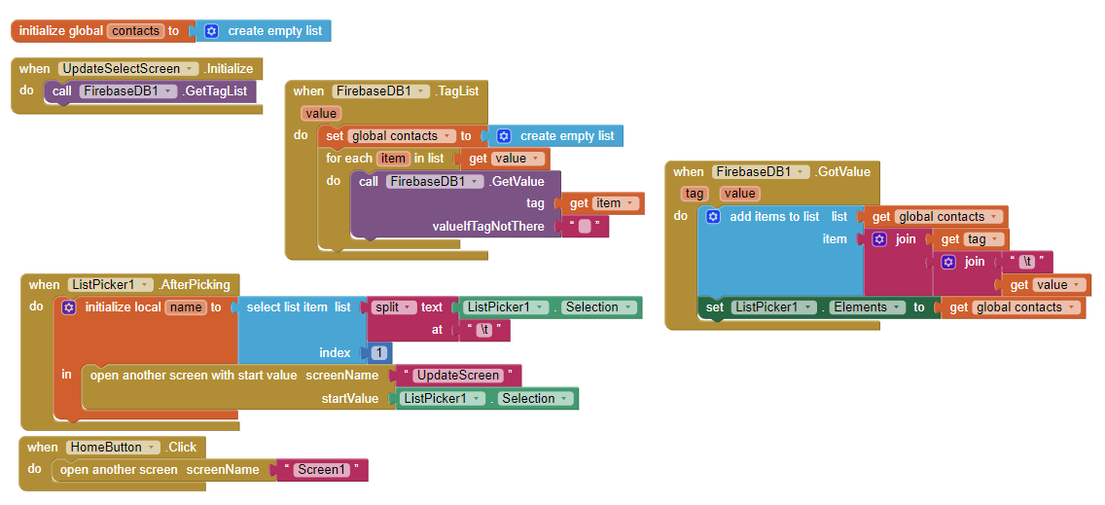
Updating Data - Selection

Slide 25

Updating Data
The second screen will have the selected contact information populated in the TextBoxes
The current tag/key will be removed from the database
A new key-value pair will be added to the database

Slide 26
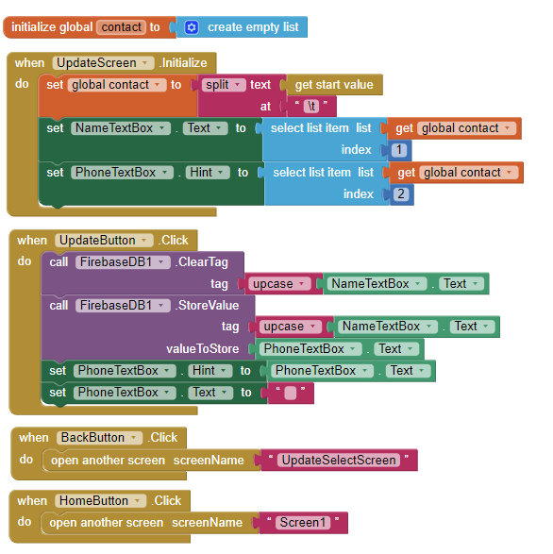
Updating Data

Slide 27
References
Follow me on Twitter @misshermans
https://rominirani.com/tutorial-mit-app-inventor-firebase-4be95051c325
https://github.com/misshermans/PhonebookAppInventor (Please change the database URL!)

